Slide 1

CCH Tagetik team –
Quartlerly team meeting
October 2025

Slide 2
Agenda
Projects and Opportunities (Q3 2025)
Training plan (follow up)
Knowledge transfer sessions:
      KT1: Planning model using dynamic business rules (Youssef)
      KT2: Data volume management and Advanced dynamicity (Zhongdi)
Varia/open discussions:
        Asset environnent and demohub
        Tagetik RCGT knowledge base (One Note)
        Suivi Objectifs 2025
        Other topics

Slide 3
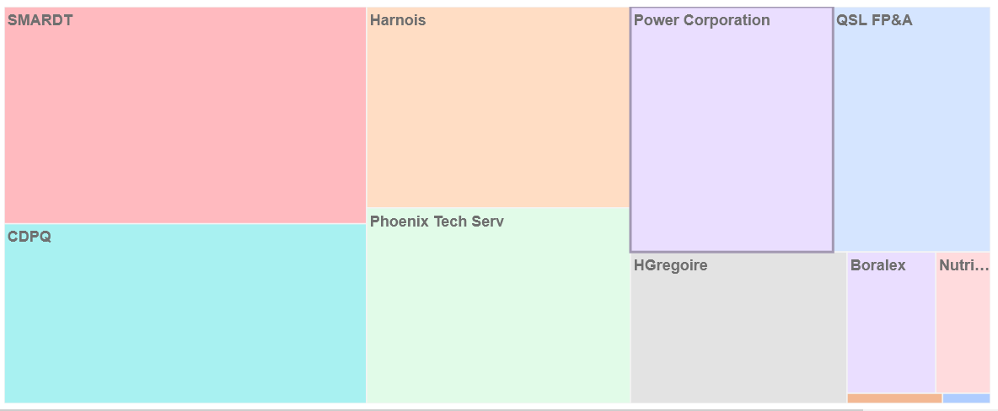
Projects – Q3 2025
In progress:
SmarDT (Conso and FP&A)
CDPQ (Planning Models Phase 2)
Harnois (Planning R&M, OPEX, WFP)
Phoenix (Conso)
Power Corporation (Conso, ID)
QSL (FP&A)
Hgregoire (Conso)
Boralex (Conso, FP&A)
Support: Bausch Health, Groupe Nutri
Not started:
Smardt (FP&A and Conso db merge)
AIM (Conso evolutions)
Energir (Conso)
Harnois (Intelligent Disclosure)
Aéroport de Montréal (Conso)
Canimex (Allocation and Reporting)
Opportunities:
Groupe Desgagnés
Sagard
BNC
Innovair
Solmax
Occupation client – Q3 2025

Slide 4
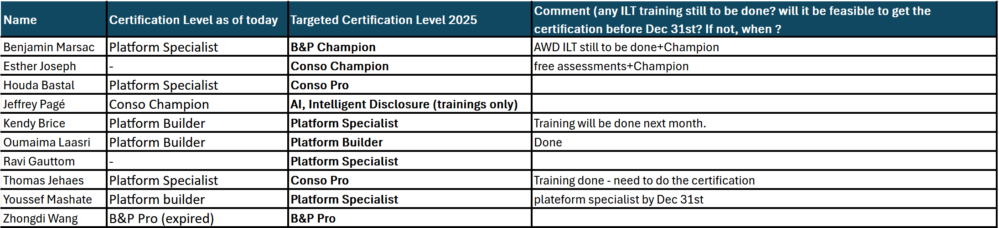
Training plan (follow up)

Slide 5

Plan de formation CCH Tagetik
Formation et Certification Tagetik se font selon 2 axes principaux:
Consolidation
Budgeting & Planning

Slide 6


Plan de formation CCH Tagetik

Slide 7
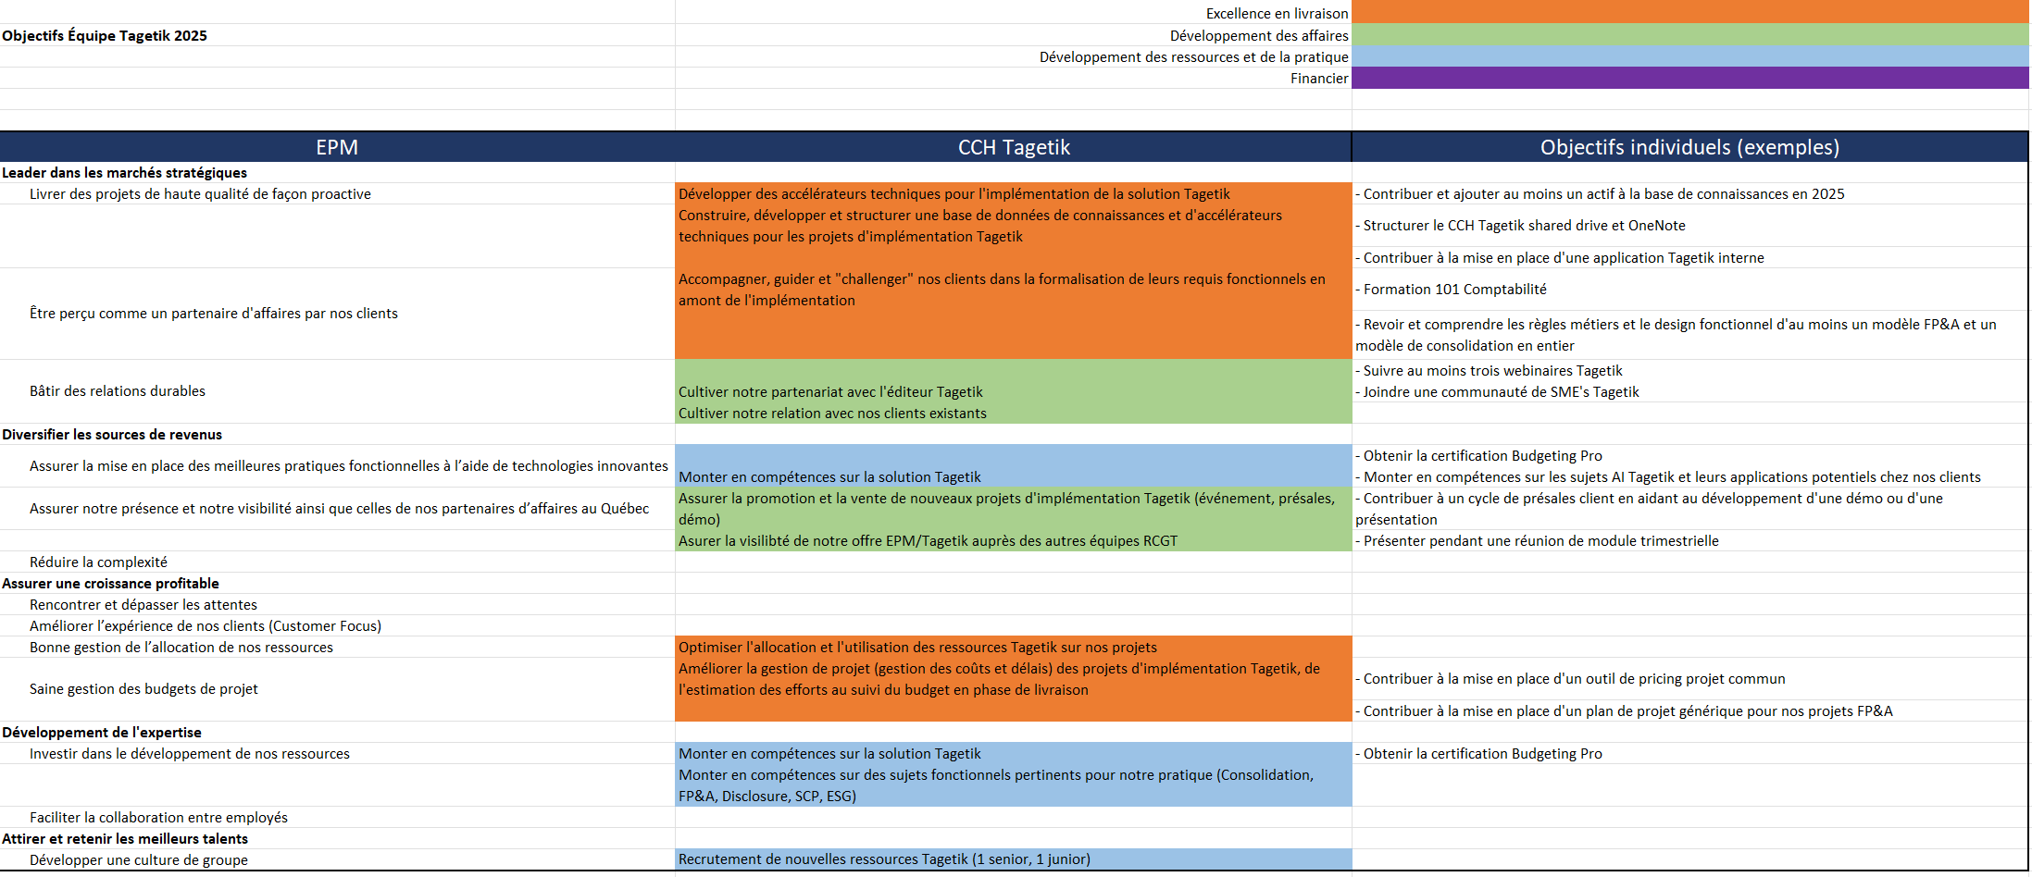
Objectifs et initiatives de l’équipe Tagetik

Slide 9
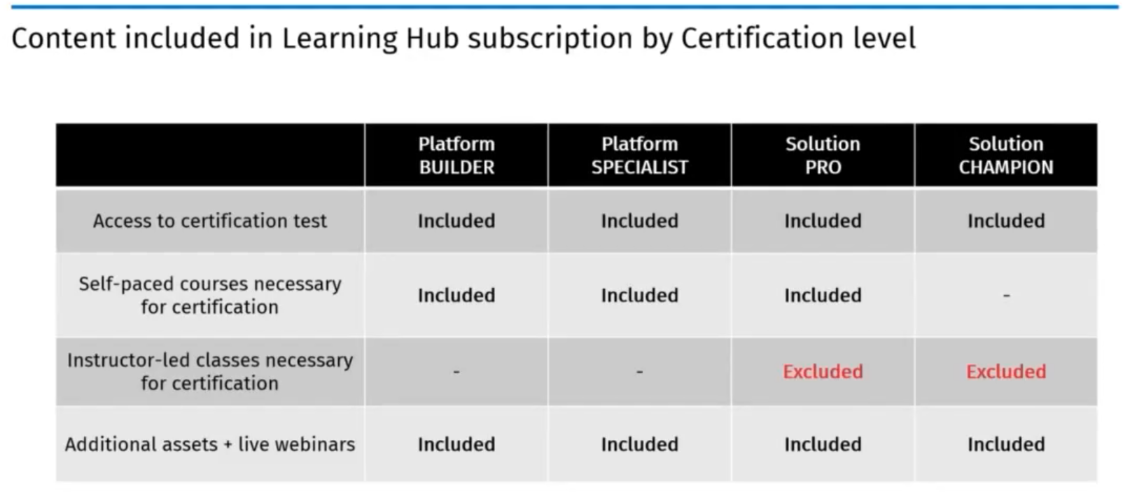
CCH Tagetik virtual partner kickoff – Faits saillants
For customer:
Admin: 1500 eur/year
Contributor: 250 eur/year
For partner:
TBC
Available in English, French, Italian

Slide 10
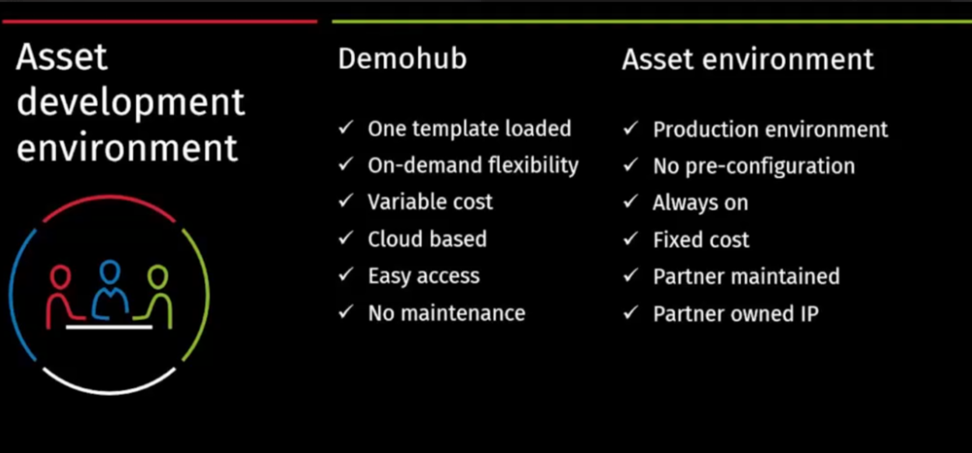
CCH Tagetik virtual partner kickoff – Faits saillants

